Slide 1


Slide 2
Encounters With Jesus - 9
“The Couple Caught In Adultery”
John 8:2-11
Andy Acreman, Thurrock Christian Fellowship
Sunday 13th September 2026

Slide 3
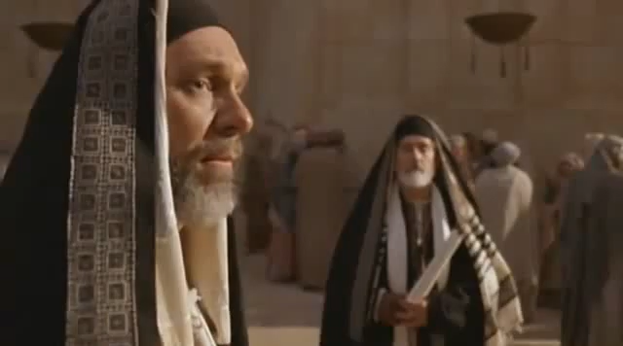

Slide 4
John 8:2-11 NIV
At dawn he appeared again in the temple courts, where all the people gathered around him, and he sat down to teach them. ³ The teachers of the law and the Pharisees brought in a woman caught in adultery. They made her stand before the group ⁴ and said to Jesus, “Teacher, this woman was caught in the act of adultery. ⁵ In the Law Moses commanded us to stone such women. Now what do you say?” ⁶ They were using this question as a trap, in order to have a basis for accusing him. But Jesus bent down and started to write on the ground with his finger.

Slide 5
John 8:2-11 NIV
⁷ When they kept on questioning him, he straightened up and said to them, “Let any one of you who is without sin be the first to throw a stone at her.” ⁸ Again he stooped down and wrote on the ground. ⁹ At this, those who heard began to go away one at a time, the older ones first, until only Jesus was left, with the woman still standing there. ¹⁰ Jesus straightened up and asked her, “Woman, where are they? Has no one condemned you?” ¹¹ “No one, sir,” she said. “Then neither do I condemn you,” Jesus declared. “Go now and leave your life of sin.”

Slide 6
What Did the Law of Moses Say?
Leviticus 20:10 NIV
“ ‘If a man commits adultery with another man’s wife—with the wife of his neighbour—both the adulterer and the adulteress are to be put to death.
Deuteronomy 17:6-7 NLT
But never put a person to death on the testimony of only one witness. There must always be two or three witnesses. ⁷ The witnesses must throw the first stones, and then all the people may join in. In this way, you will purge the evil from among you.

Slide 7
What Did Jesus Write On the Ground?
Hosea 4:14 NIV
"I will not punish your daughters when they turn to prostitution, nor your daughters-in-law when they commit adultery, because the men themselves consort with harlots and sacrifice with shrine prostitutes…”.

Slide 8
Our English Cultural Sayings…
“When in Rome…”
“The early bird…”
“A picture is worth…”
“It takes a village…”
“Don’t throw the…”
“Don’t count your…”
“A stitch in time…”
“Don’t tell him your name…”

Slide 9
What Did Jesus Write On the Ground?
Hosea 4:14 NIV
"I will not punish your daughters when they turn to prostitution, nor your daughters-in-law when they commit adultery, because the men themselves consort with harlots and sacrifice with shrine prostitutes…”.

Slide 10
How Was Capital Punishment Administered?
Deuteronomy 17:6-7 NLT
But never put a person to death on the testimony of only one witness. There must always be two or three witnesses. ⁷ The witnesses must throw the first stones, and then all the people may join in. In this way, you will purge the evil from among you.

Slide 11
Romans 3:25-26 NLT
For God presented Jesus as the sacrifice for sin. People are made right with God when they believe that Jesus sacrificed his life, shedding his blood. This sacrifice shows that God was being fair when he held back and did not punish those who sinned in times past, ²⁶ for he was looking ahead and including them in what he would do in this present time. God did this to demonstrate his righteousness, for he himself is fair and just, and he makes sinners right in his sight when they believe in Jesus.

Slide 12
How Can We Apply This?
Avoid ‘labels’, gossip, and judgement of one another
Seek the Holy Spirit for guidance in every situation
Get to know the Bible really well – read it daily
Understand how God can be both a Judge and merciful to us
As Christians: Don’t do as you please; do as He pleases
Are we hypocritical, performative, shallow?
How do we view people who are ‘more sinful’ than us?
Have you come to Jesus for forgiveness yet?

